Slide 1
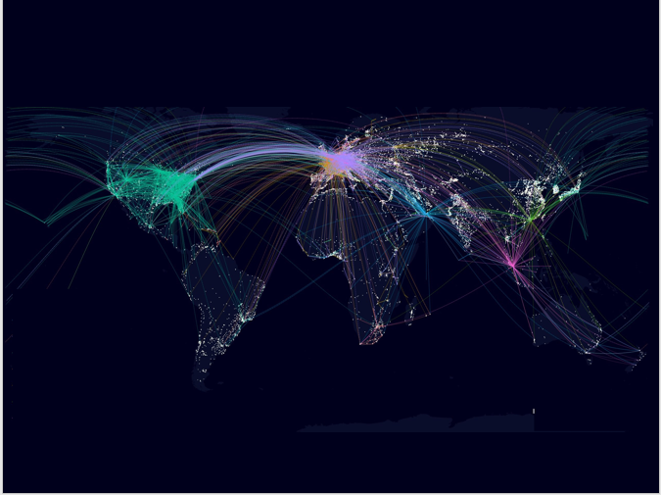
-By
Chinmay Ajnadkar
Heer Narang
Srivatsan Narayanan
Sindhoora Kommineni
Urvi Bahety

Slide 2
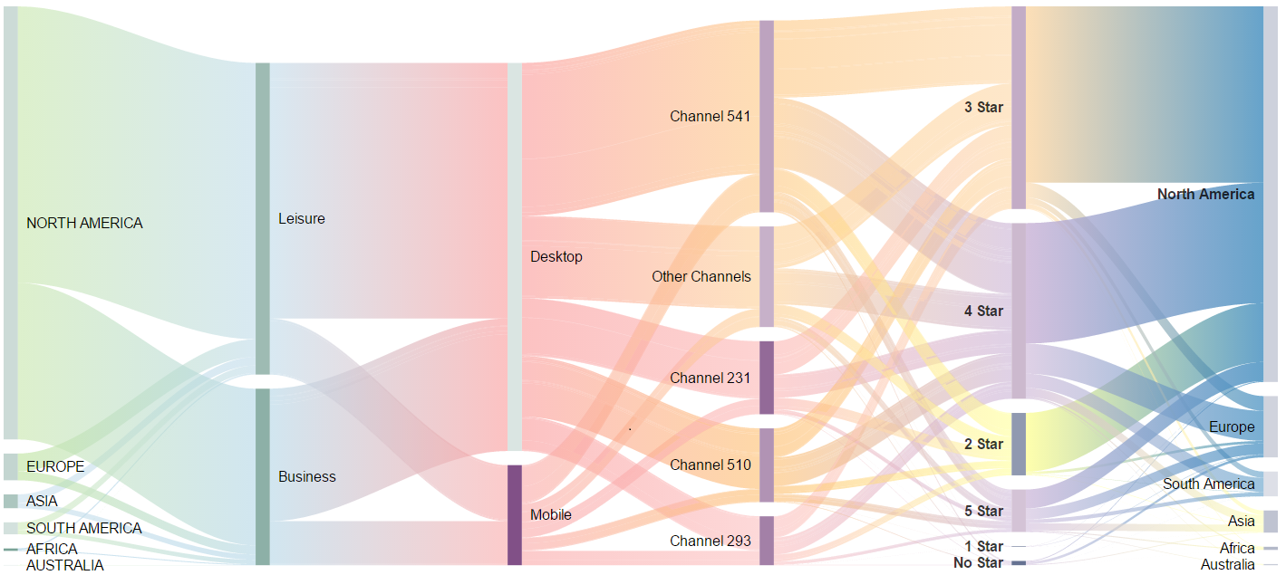

Slide 3


Slide 4
